Slide 1
CTE and CTSOs
Career and Technical Education
Career and Technical Student Organizations
Student Success
American Success

Slide 2
Career & Technical Education= student success
• It’s for students who want to “do” things
• It adds relevance to instruction
• It strengthens academic achievement

Slide 3
Career & Technical Education students
• Learn by doing.
• The skills they learn lead to careers. . .
• Careers America is counting on

Slide 4
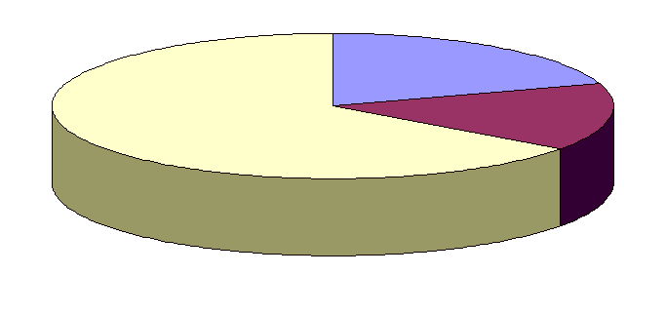
Career outlook
Only 20% of all jobs are in professions
JOBS
65% of all jobs are skilled occupations
Only 15% are unskilled
Source: U.S. Dept. of Labor

Slide 5
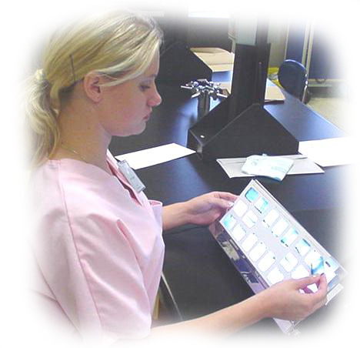
Career outlook
Largest, fastest-growing part of American economy is the technical workforce.
Occupational skills are in demand and well paid.

Slide 6
Who takes CTE courses?
96% of all high school students take a course
20% of all high school credits are in CTE
44% take three or more Career and Technical Education classes
Source: U.S. Dept. of Education

Slide 7
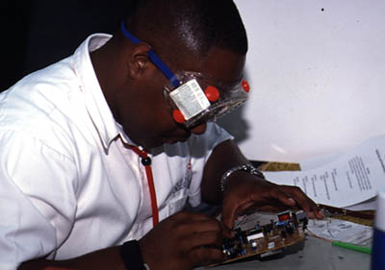
What do students need to succeed?
CTE teaches….
Academic skills
Job skills
Employability skills

Slide 8
What are employability skills?
Team working
Leadership
Goal setting
Resource management
Using technology
Personal responsibility
Higher-order thinking
Communications

Slide 9
Are employability skills important?
“The major skills lacking in. . .workers are basic employability skills. . .”
National Association of Manufacturers, 2001

Slide 10
These essential skills promote:
• Academic success
• Career success
• Positive attitudes
• Self-confidence

Slide 11
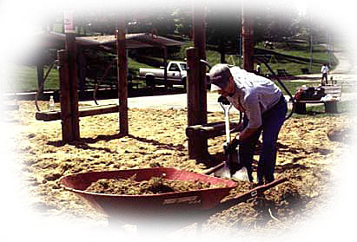
CTE prepares students for:
College
Careers
Life and leadership in their communities

Slide 12
CTE and CTSOs
A Partnership for Student Success

Slide 13
Student organizations are integral to instruction
Career and Technical Student Organizations (CTSOs)
Unique in public education
Co-curricular activities and experiences for students
The way CTE teaches employability skills
Strengthen CTE instruction overall

Slide 14
National co-curricular CTSO’s
There is a CTSO for every discipline
Included in federal legislation
Endorsed by the National Association of Secondary School Principals
Recognized by the U.S. Department of Education
Supported by state directors of CTE and
Supported by state departments of education

Slide 15
Together, they represent:
Over 1.6 million students annually
Over 58,000 instructors
Over 45,500 chapters
3,081 national business sponsors and partners

Slide 16
In Arizona they represent:
Over 50,000 Students
Instructors
Chapters
Businesses and Sponsors

Slide 17
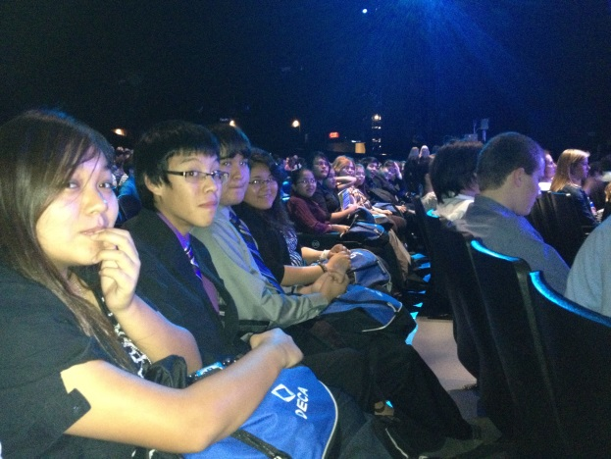
Who are they?
An Association of
Marketing Students

Slide 18
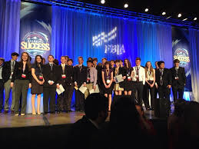
Who are they?
Future Business Leaders of America

Slide 19
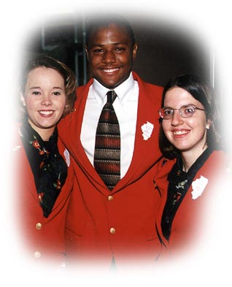
Who are they?
Family, Career and
Community Leaders of
America (FCCLA)
Family & Consumer Sciences Students

Slide 20
Who are they?
Health Occupations
Students of America
(HOSA)

Slide 21
Who are they?
National FFA
Organization

Slide 22
Who are they?
SkillsUSA
Industrial Education Students

Slide 23
Who are they?
Future Educators Association (FEA)

Slide 24
Value added to CTE
Exciting activities supporting curriculum
Hands-on and academic applications
Student experiences including competitions and leadership seminars
Student identity

Slide 25
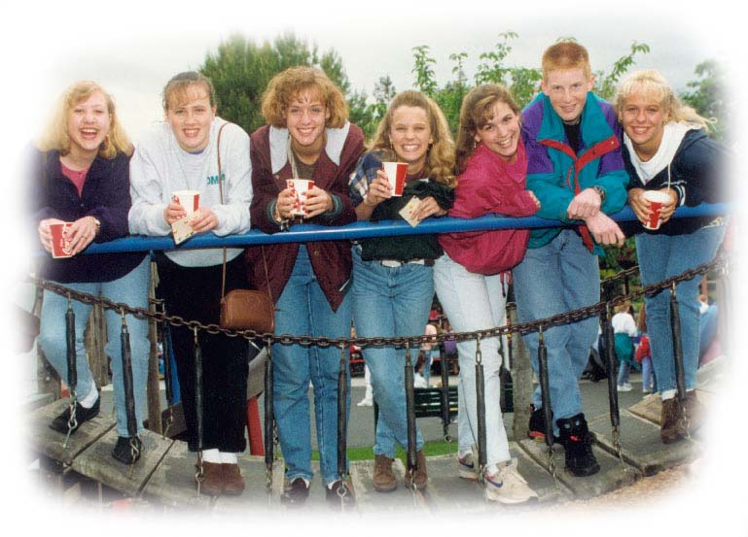
Value added to CTE
Student experiences as citizens
• Community involvement

Slide 26
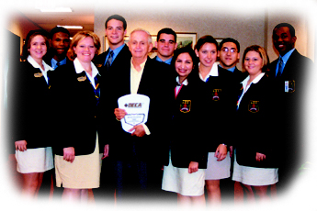
Value added to CTE
Industry partnerships
Involve industry in classroom and labs
Help CTE meet industry standards
National, state and local partnerships
Valued in the millions of dollars
Supporting students and instruction

Slide 27
Examples of programs
College scholarships
Instructor scholarships
“Virtual Business Challenge”
Student/instructor workshops
Internet-based courses
Skill competitions based on national standards
Technology Business Skills Certification
National Technology Achievement Award
“Directions” Officer Training
“Professional Development Program”

Slide 28
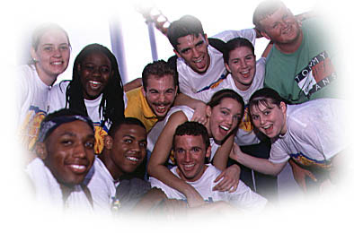
CTSOs connect students
To industry
To their instructors
CTSOs connect students to their individual success
We leave no child behind
To each other

Slide 29
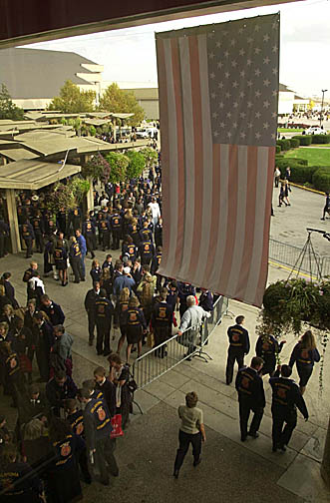
Student Success
There are 13 million students in high school
Each one wants to be successful at work and in life
CTE and CTSOs are dedicated to helping each student reach that goal

Slide 30
CTE prepares students for success
College
Career
Community

Slide 31
CTSOs make the success connection
Professional skills
Experiences
Networking
Self-esteem
Leadership
Personal skills

Slide 32
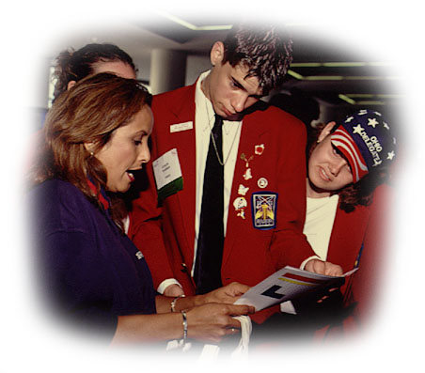
Student organizations help:
Instructors teach
Industry find qualified workers
Students learn skills for success
Our economy grow

