Slide 1
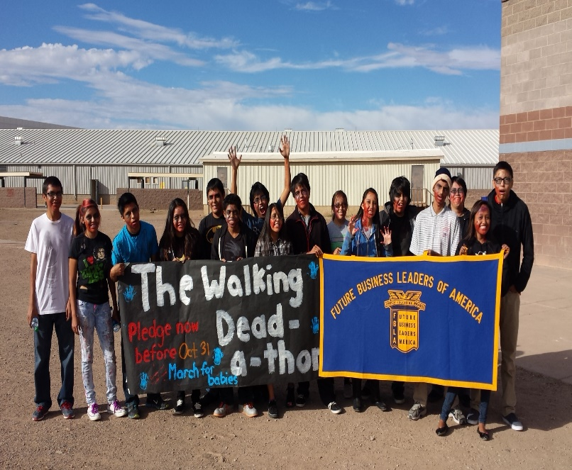
CHINLE HIGH SCHOOL CTE Spring Advisory Committee Meeting

Slide 2
Welcome Address- Mr. Chris Smith, CTE Director
CHINLE HIGH SCHOOL CTE Spring Advisory Committee Meeting

Slide 3
Invocation- Brandon Tso, Drafting Teacher
CHINLE HIGH SCHOOL CTE Spring Advisory Committee Meeting

Slide 4
Introduction of CTE Staff and Committee Members
CHINLE HIGH SCHOOL CTE Spring Advisory Committee Meeting

Slide 5
Dinner
CHINLE HIGH SCHOOL CTE Spring Advisory Committee Meeting

Slide 6
Advisory Team Meeting
CHINLE HIGH SCHOOL CTE Spring Advisory Committee Meeting
Local Team Evaluation Forms
Advisory Agreement Form FY 2015-2016

Slide 7
CTE SCHOOL YEAR RECAP FOR 2014-2015
CHINLE HIGH SCHOOL CTE Spring Advisory Committee Meeting
Equipment Purchased
Funding from Native JTED
CTE Programs Achievements

Slide 8
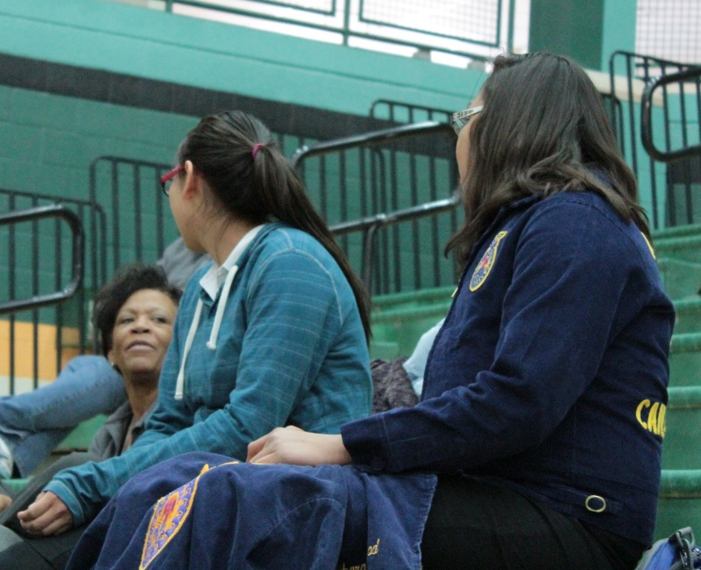
CAREER TECHNICAL STUDENT ORGANIZATION
Ms. Pogue
HOSA
HOSA- Ms. Pogue

Slide 9
CAREER TECHNICAL STUDENT ORGANIZATION
Mr. Sherry
Skills, USA
Malencia Yazzie
Scholarship $2500
Placed top 15
CCAP Culinary Competition

Slide 10
CAREER TECHNICAL STUDENT ORGANIZATION
Mr. Sherry
Skills, USA
Marrec Clement
Scholarship $3000
Placed top 15
CCAP Culinary Competition

Slide 11
CAREER TECHNICAL STUDENT ORGANIZATION
Ms. Jimmy
FBLA
Gabrielle Lee
Accounting II
Junior
5th Place
Qualified for Nationals in Chicago, IL in July

Slide 12
CAREER TECHNICAL STUDENT ORGANIZATION
Mr. Kimbrough
Ms. Lee
Mr. Anderson
Ms. Pogue
Mr. Wagner
Mr. Nelson
Mr. Gilliam
NATIVE SKILLS

Slide 13
CAREER TECHNICAL STUDENT ORGANIZATION
Mr. Sherry
NATIVE SKILLS
Marrec Clement
Gold Medal Winner
NATIVE SKILLS COMPETITION
Tuba City, AZ

Slide 14
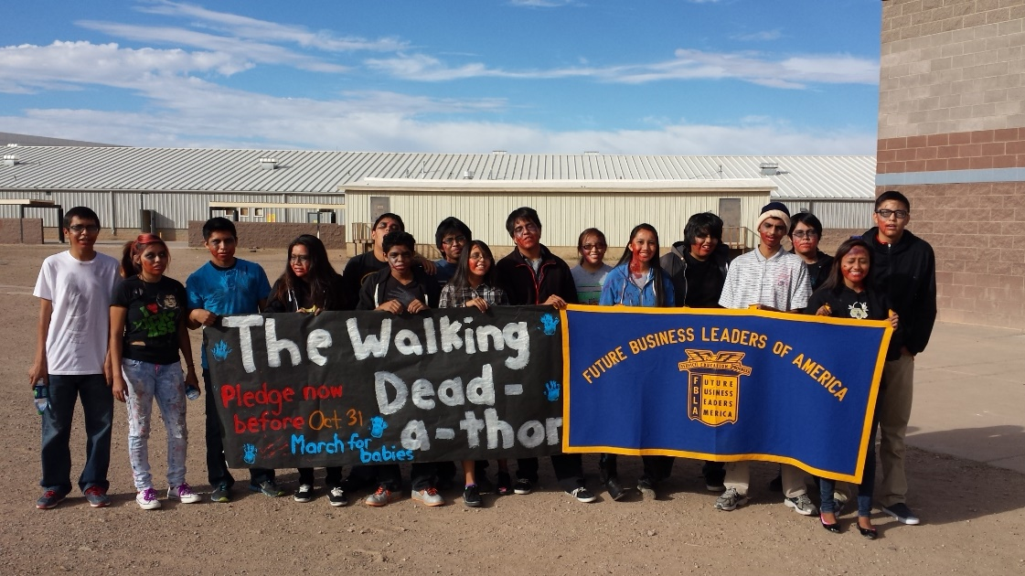
CAREER TECHNICAL STUDENT ORGANIZATION
Ms. Jimmy
FBLA
Thanksgiving Community Service Project
Walking Dead
Office Leadership Camp
FLEX
SLC

Slide 15
CAREER TECHNICAL STUDENT ORGANIZATION
Ms. Jimmy
FBLA
Gabrielle Lee
Accounting II
Junior
5th Place
Qualified for Nationals in Chicago, IL in July

Slide 16
CAREER TECHNICAL STUDENT ORGANIZATION
Mr. Anderson
FBLA
Network Design
5th Place
Team Event
Bert Begay, Senior
Antonio Yazzie, Junior
Kristopher Pouncy, Junior

Slide 17
CAREER TECHNICAL STUDENT ORGANIZATION
Mr. Anderson
FBLA
Kristopher Pouncy
Junior
5th Place
Network Design (Team)
7th Place
Help Desk (Role Play)
8th Place
Network Concepts (Objective Test)

Slide 18
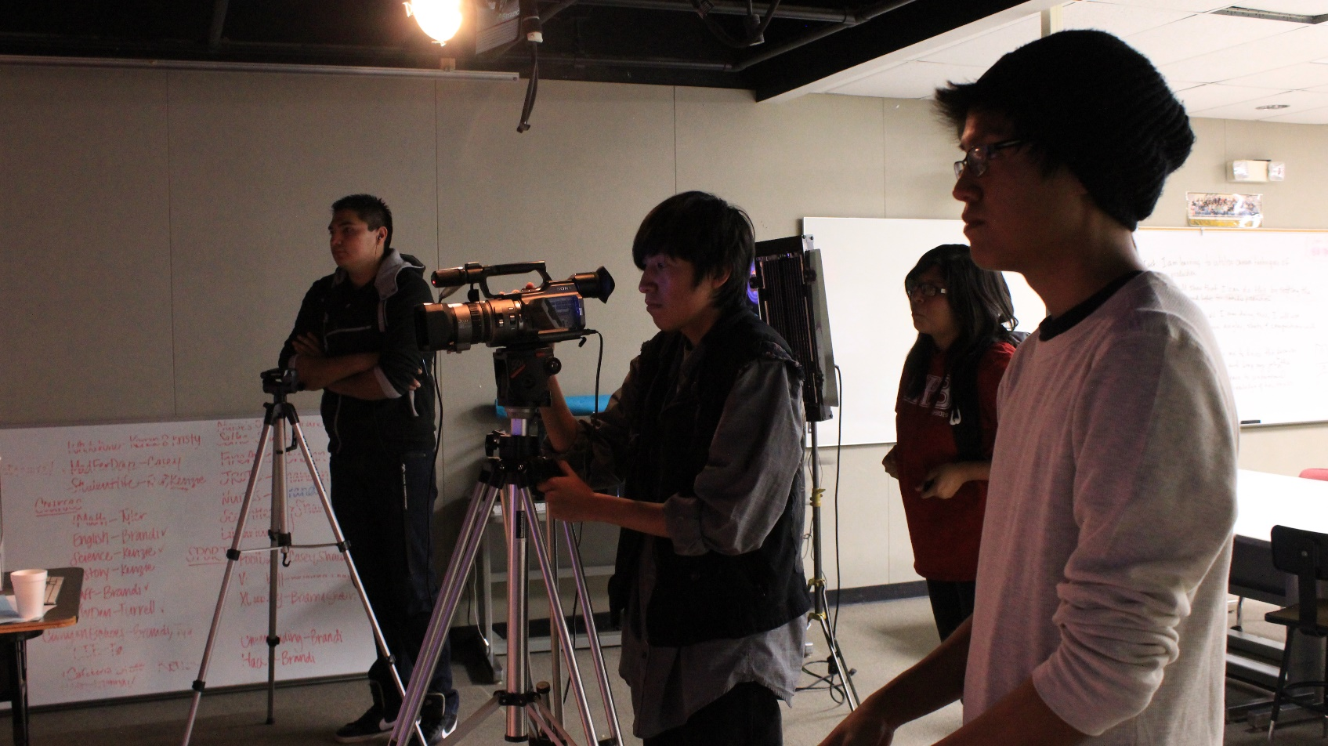
CAREER TECHNICAL STUDENT ORGANIZATION
YEARBOOK- Mr. Nelson
Pictures by Mr. Nelson from his yearbook club.

Slide 19
Announcements
CHINLE HIGH SCHOOL CTE Spring Advisory Committee Meeting
NATIVE Meeting
CTE Spring Assessments
Farewell- T. Gilliam

Slide 20
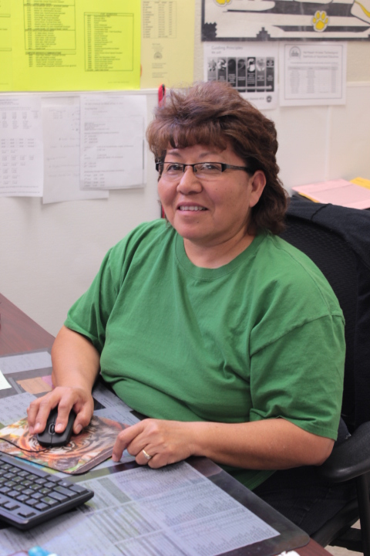
CHINLE HIGH SCHOOL CTE Spring Advisory Committee Meeting
Closing- Mr. Smith

Slide 21
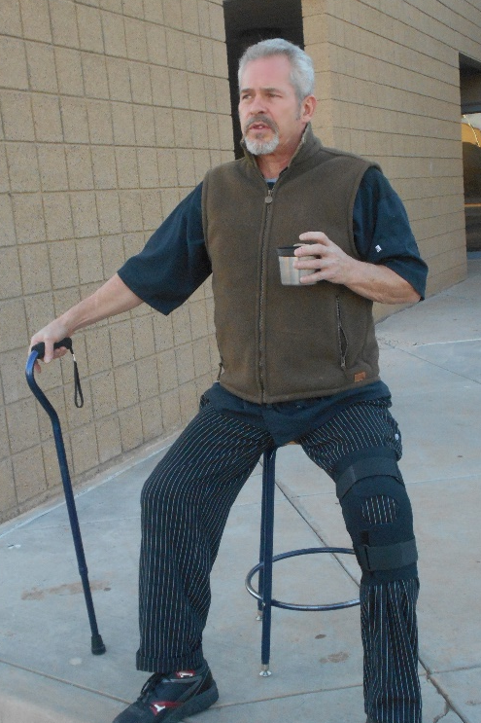
CHINLE HIGH SCHOOL CTE Spring Advisory Committee Meeting
Closing- Mr. Smith

Slide 22
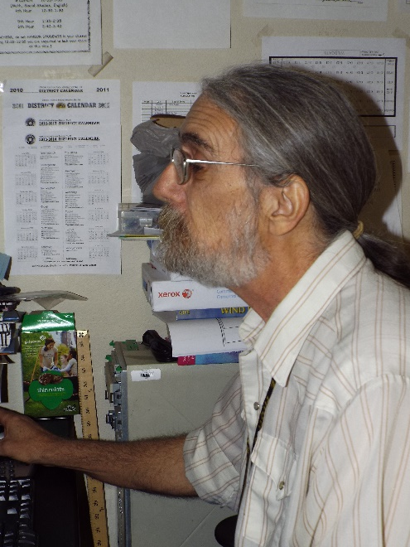
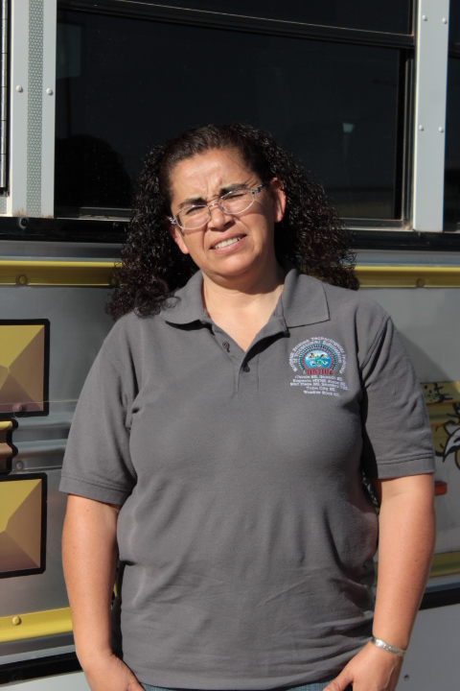
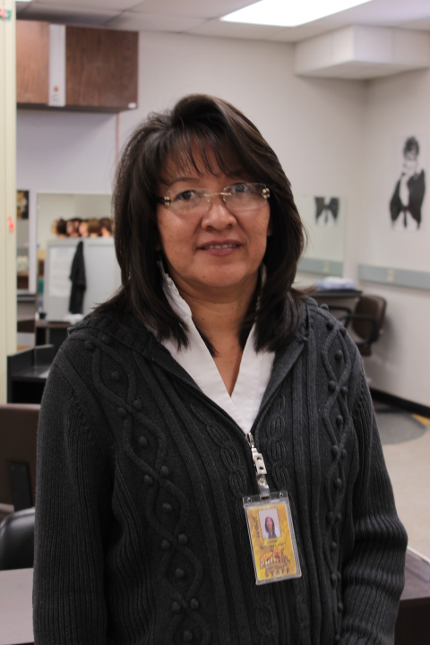
CHINLE HIGH SCHOOL CTE Spring Advisory Committee Meeting
Closing- Mr. Smith

Slide 23
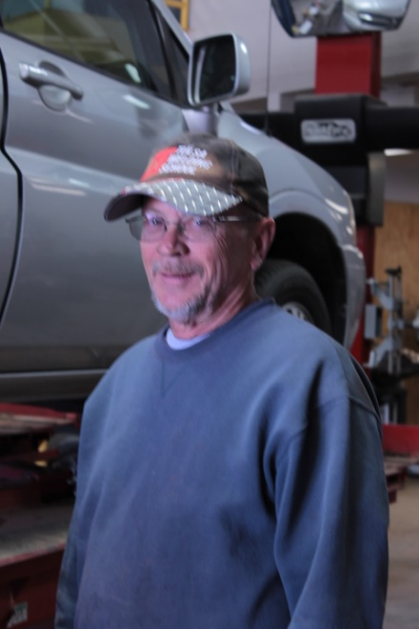
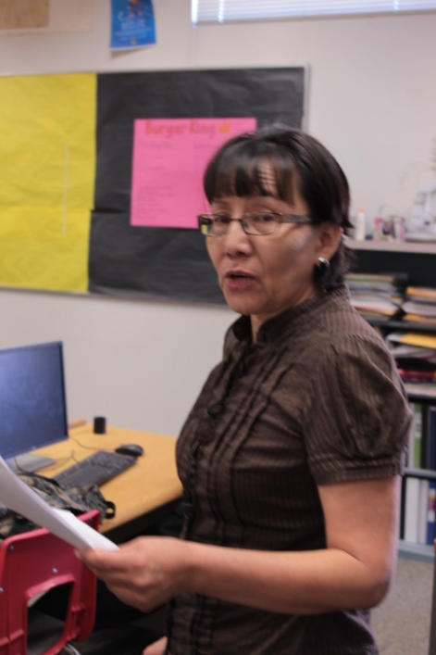
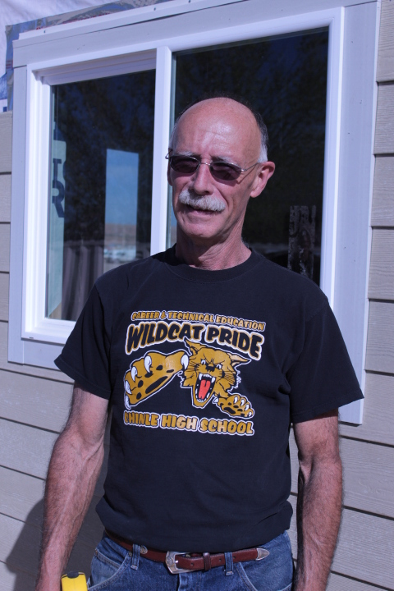
CHINLE HIGH SCHOOL CTE Spring Advisory Committee Meeting
Closing- Mr. Smith

Slide 24
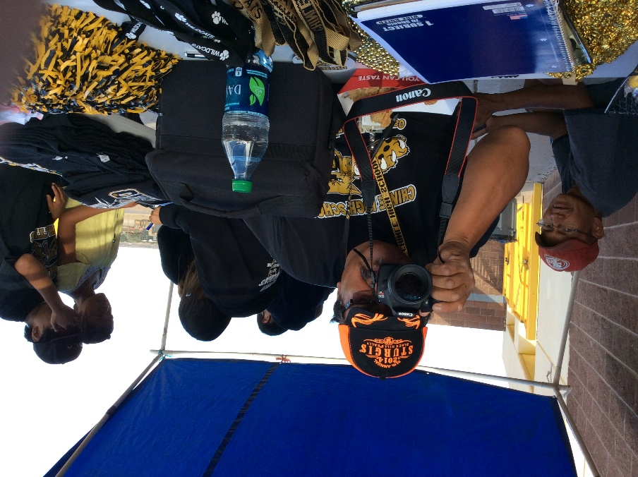
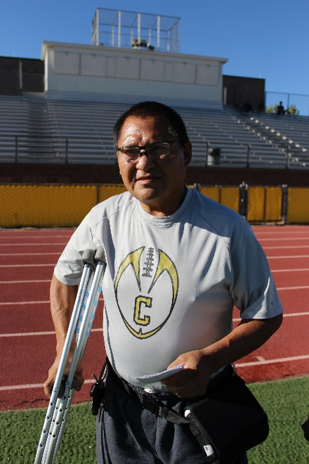
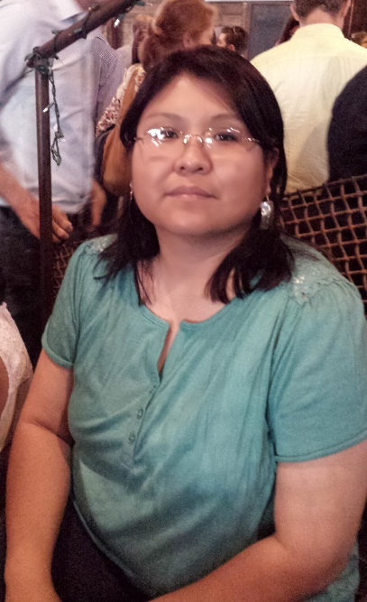
CHINLE HIGH SCHOOL CTE Spring Advisory Committee Meeting
Closing- Mr. Smith

Slide 25
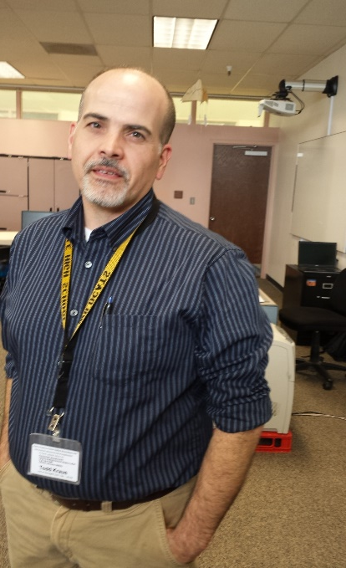
CHINLE HIGH SCHOOL CTE Spring Advisory Committee Meeting
Closing- Mr. Smith

